Slide 1
Threads Introduction
Spring 2022

Slide 2
Reference
Modern Operating System
2.2.1 The Thread Model
2.2.2 Thread Usage
Andrew S. Tanenbaum
2nd edition

Slide 3
Thread: Introduction
Each process has
  Own Address Space
  Single thread of control
A process model has two concepts:
  Resource grouping
  Execution
Sometimes it is useful to separate them

Slide 4
Unit of Resource Ownership
A process has an
  Address space
  Open files
  Child processes
  Accounting information
  Signal handlers
If these are put together in a form of a process, can be managed more easily

Slide 5
Unit of Dispatching
Path of execution
  Program counter: which instruction is running
  Registers:
    holds current working variables
  Stack:
    Contains the execution history, with one entry for each procedure called but not yet returned
  State
Processes are used to group resources together
Threads are the entities scheduled for execution on the CPU
Threads are also called lightweight process

Slide 6
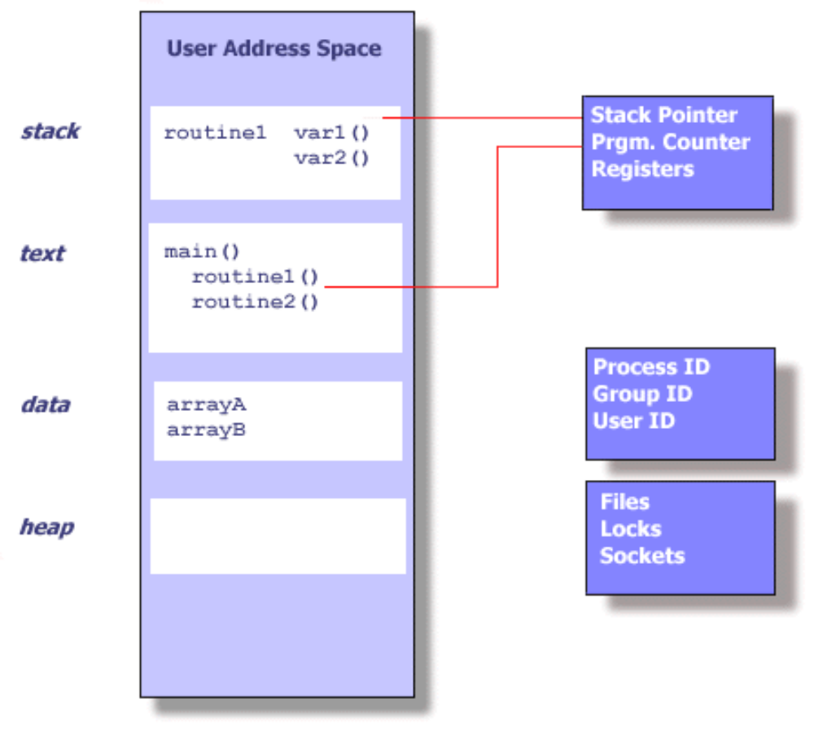
UNIX Process

Slide 7
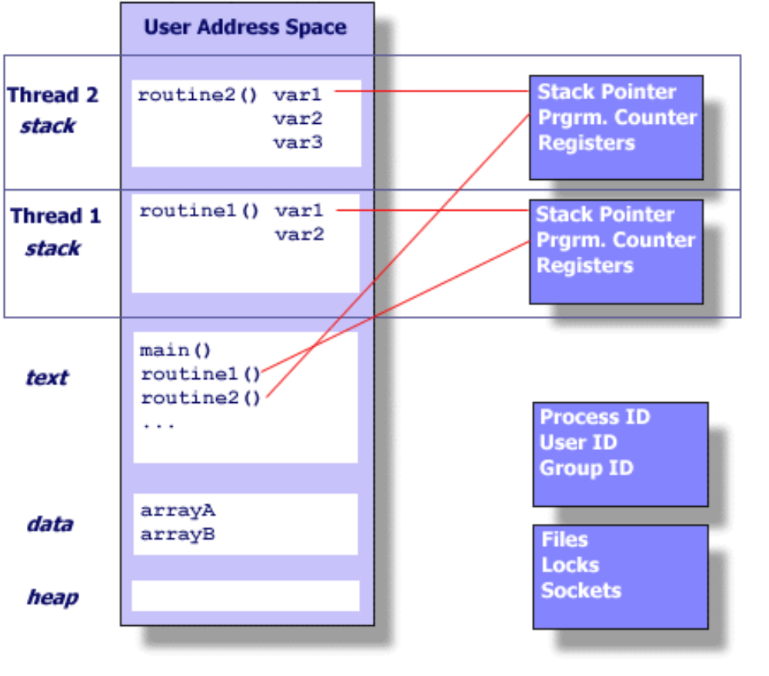
Threads within a UNIX Process

Slide 8
Its better to distinguish between the two concepts
  Address space/Global Variables
  Open files
  Child processes
  Accounting info
  Signal handlers
  Program counter
  Registers
  Stack
  State
Heavy weight process
In case of multiple threads per process
Unit of Resource
Split
Unit of Dispatch
  Address space/Global Variables
  Open files
  Child processes
  Accounting Info
  Signal Handlers
  Program Counter
  Registers
  Stack
  State
Light weight processes
  Program Counter
  Registers
  Stack
  State
  Program Counter
  Registers
  Stack
  State
Share

Slide 9
Threads
Allow multiple execution paths in the same process environment
Threads share address space, open files etc
But have own set of Program counter, Stack etc
The first thread starts execution with
  int main(int argc, char *argv[])
The threads appear to the Scheduling part of an OS just like any other process

Slide 10

Process Vs. Threads
(a) Three threads, each running in a separate address space
(b) Three threads, sharing the same address space

Slide 11

The Thread Model
Each thread has its own stack

Slide 12
Thread Usage
Less time to create a new thread than a process
    the newly created thread uses the current process address space
    no resources attached to them
Less time to terminate a thread than a process.
Less time to switch between two threads within the same process, because the newly created thread uses the current process address space.
Less communication overheads
    threads share everything: address space, in particular. So, data produced by one thread is immediately available to all the other threads
Performance gain
    Substantial Computing and Substantial Input/Output
Useful on systems with multiple processors

Slide 13
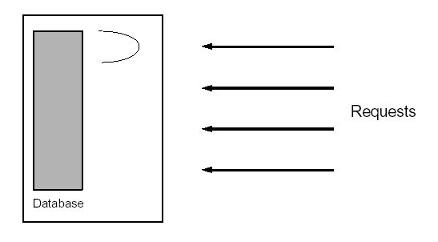
1. Single threaded database server
Handles multiple clients
  Either handle the requests sequentially
  Or multiplex explicitly by creating multiple processes
Problems
  Unfair for quick requests, occurring behind lengthy request
  Complex and error prone
  Heavy IPC required

Slide 14
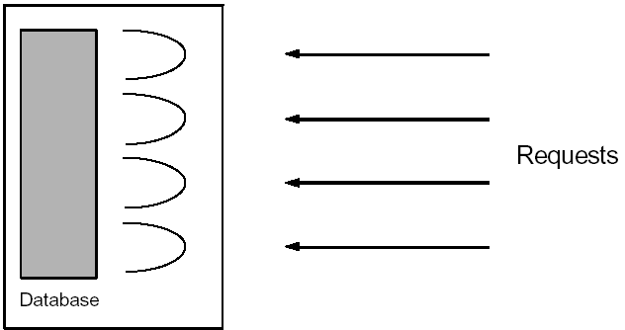
1. Multithreaded database server
Assign a separate thread to each request
As fair as in the multiplexed approach.
The code is as simple as in the sequential approach, since the address space is shared - all variables are available
Some synchronization of access to the database is required, this is not terribly complicated.

Slide 15

e.g. A multithreaded web server

Slide 16

2. Background Processing
Consider writing a GUI-based application that uses:
  Mouse
  Keyboard input
  Handles various clock-based events
In a single threaded application, if the application is busy with one activity, it cannot respond (quickly enough) to other events, such as mouse or keyboard input.
Handling such concurrency is difficult and complex
But simple in a multithreaded process

Slide 17

e.g. A word processor with 3 threads

Slide 18
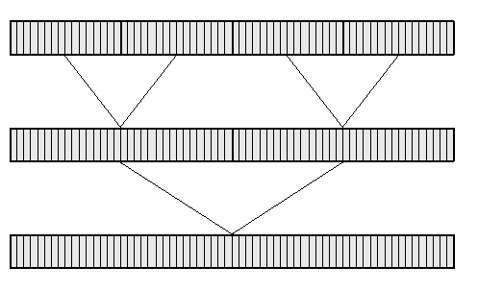
3. Parallel Algorithms e.g. Merge Sort
Sort some data items on a shared-memory parallel computer.
Our task is merely to implement a multithreaded sorting algorithm.
  Divide the data into four pieces
  Have each processor sort a different piece.
  Two processors each merge two pieces
  One processor merges the final two combined pieces.

